Slide 1
Something's Rotten at the Gilded Rose: A Refactoring Tale
Chris C
Notes:
Summary:

Slide 2


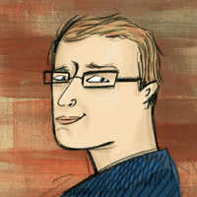

Who am I? (i.e. Shameless Self Promotion)
Software Consultant https://saturdaymp.com chris.cumming@satudaymp.com Host of: http://weeklydevchat.com/ https://www.legacycode.rocks/
Slacks Chris C on Dev Edmonton Legacy Code Rocks YegSec
Notes:
I’m a software consultant and do my work under the name of Saturday Morning Productions. I help clients ship secure high quality code faster. I’m also the creator and host of the Weekly Dev Chat which is a virtual chat every mostly about software development.
Also host Legacy Code Rocks (stole idea for WDC).
Contact me via email, Slacks, or LinkedIn. This is my picture on the Slacks.

Slide 3
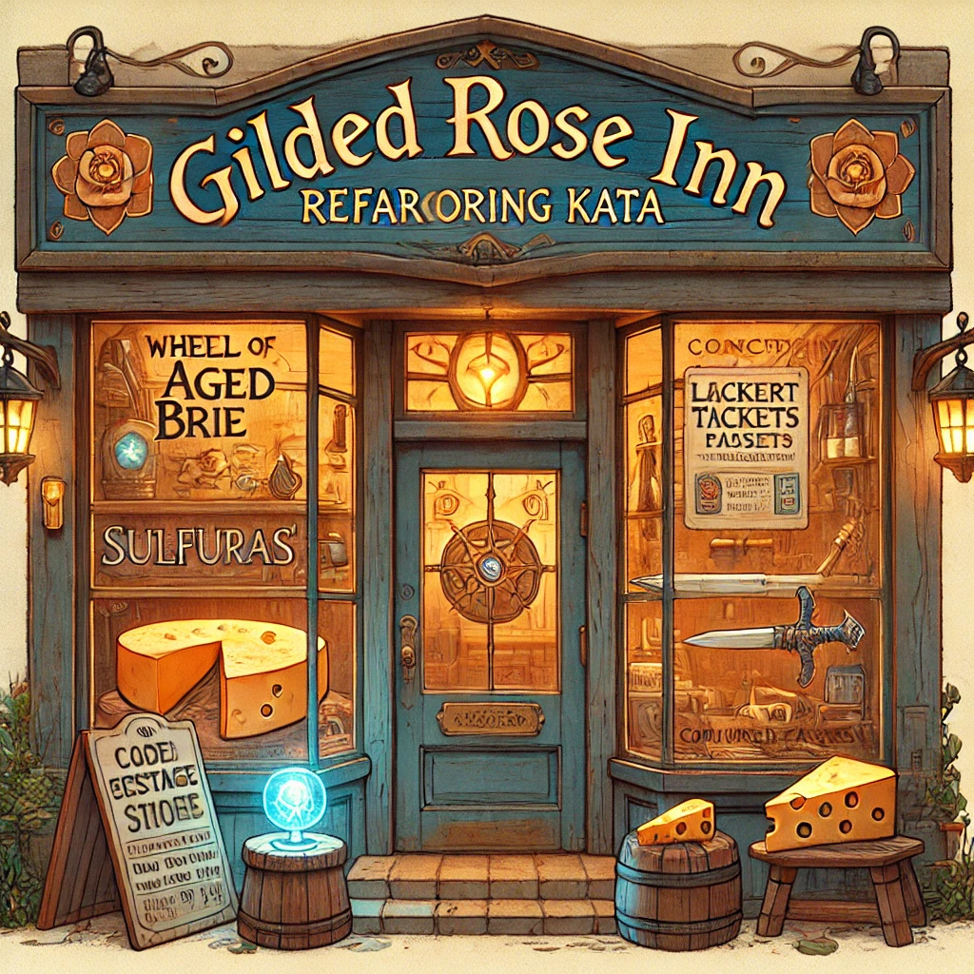
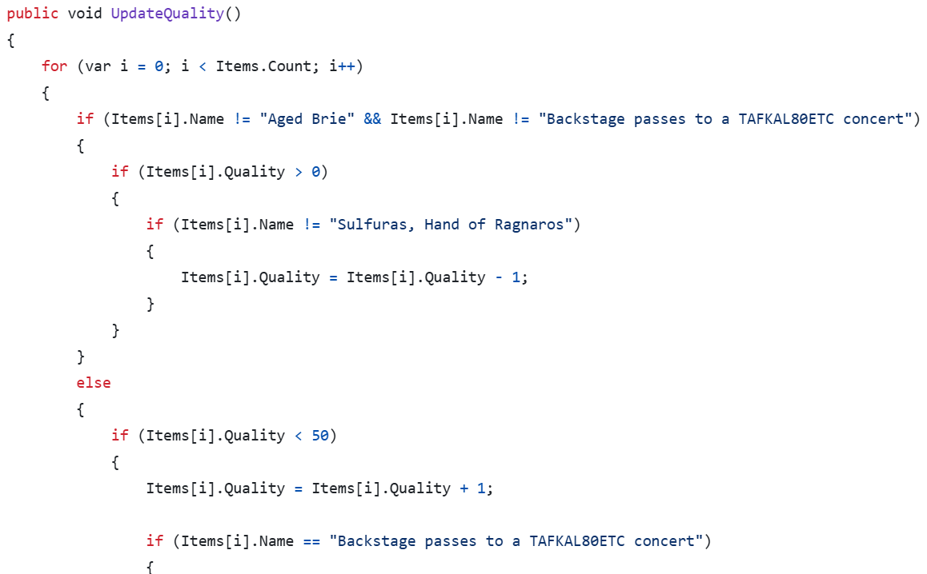
What is the Gilded Rose Kata?
Refactoring exercise created by Terry Hughes and expanded by Emily Bache
Notes:
Bache is pronounced B-A-sh.
Based of World of Warcraft, but I’ve never played the game.
Fun refactoring exercise. See requirements.

Slide 4
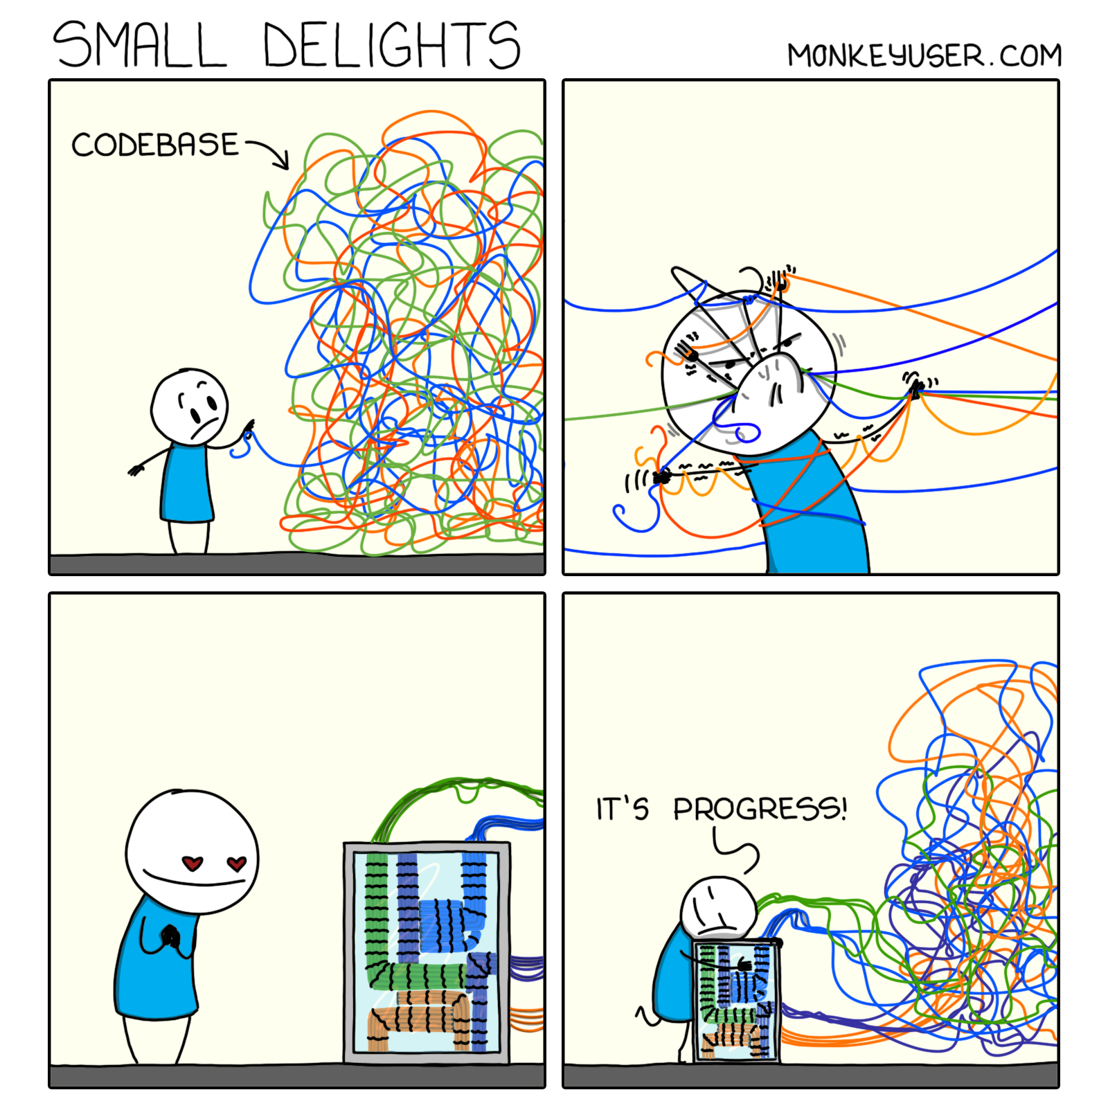

What is Refactoring?
Changing existing source code without changing its external behavior.
Notes:
Give the definition of refactoring: Changing existing source code without changing its external behavior. The user, developer or not, should not notice any differences.
Popularized by the Martin Fowler books.
Why refactor? Understand existing code. Make future changes easier.

Slide 5
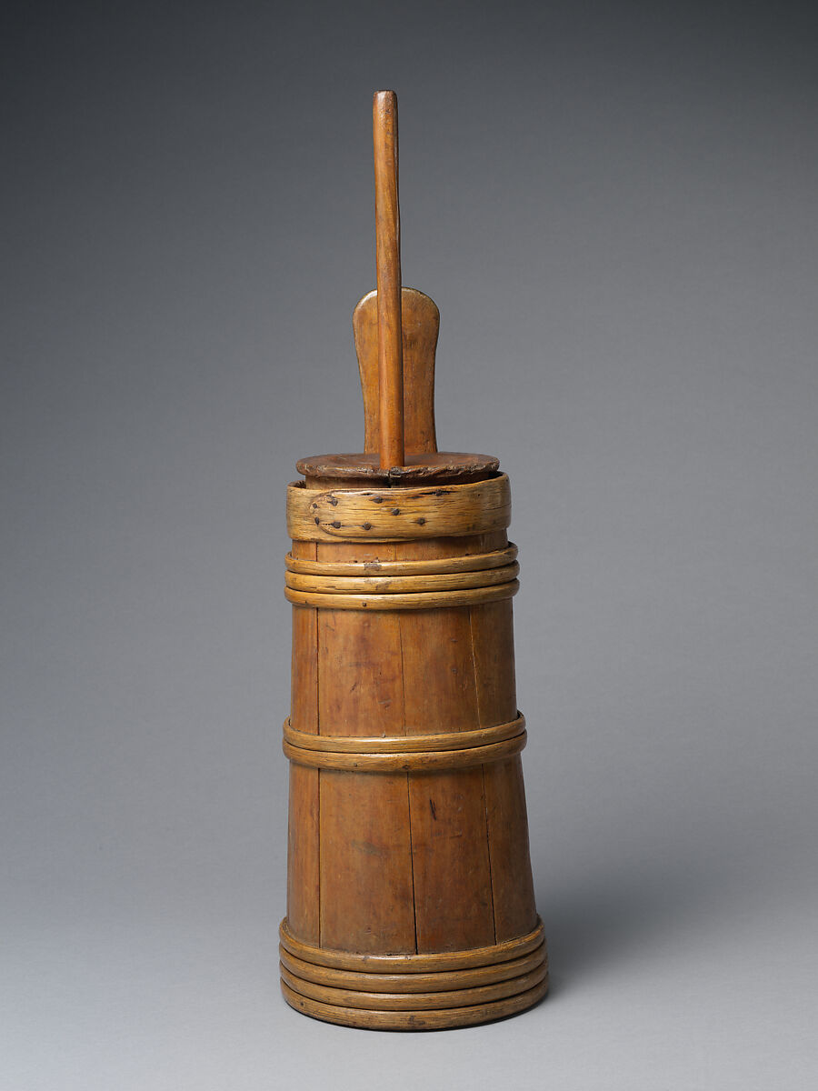
Use Churn to Know when to Refactor
The more often a file is changed the more benefit you will get from refactoring it.
Example Churn Script: https://github.com/garybernhardt/dotfiles/blob/main/bin/git-churn git log --all -M -C --name-only --format='format:' | sort | grep -v '^$' | uniq -c | sort -n
Notes:
Don’t worry about refactoring code that does not change often.
Check if developers are avoiding code because it is hard to change.

Slide 6
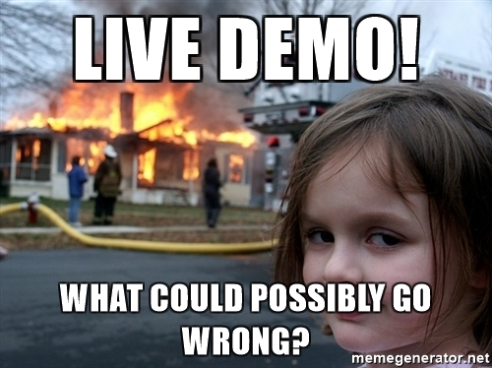
Live Refactoring
Assumptions:
Can’t edit or inherit item class
Short timeline for Conjured Mana Cakes
Camping rule: leave things better than you found them.
This is just one of many ways to refactor this kata.
Notes:
Assumption we need Conjured Mana Cakes soon. Then followed up by a couple other item types.

Slide 7
Learn More
Contact chris.cumming@satudaymp.com Chris C on Slack: Dev Edmonton Legacy Code Rocks YegSec
Slides: https://github.com/saturdaymp-examples/a-refactoring-tale
Gilded Rose Kata: https://github.com/emilybache/GildedRose-Refactoring-Kata https://www.youtube.com/@EmilyBache-tech-coach
Refactoring (Martin Fowler): https://refactoring.com/
Understand Legacy Code: https://understandlegacycode.com/
Legacy Code Rocks: https://legacycode.rocks/
SaturdayMP Videos: https://www.youtube.com/@saturdaymp
Notes:
Thank the audience and EDMUG.

